Slide 1
Development of AI/ML based solution for detection of face-swap based deep fake videos
PIP2001 Capstone Project
Review-4
Batch Number: CSE_ISR_CAP_12
Roll Number | Student Name
20211ISR0023 20211ISR0086 20211ISR0073 | Naga Nikhitha P Sarthak Mishra Darshan S
Under the Supervision of,
Dr. Mohammedi Akheela Khanum
Professor
School of Computer Science and Engineering
Presidency University
Name of the Program: B. TECH(Information Science and Engineering with AI and Robotics)
Name of the HOD: Dr. Zafar Ali Khan
Name of the Program Project Coordinator: Dr. Afroz Pasha
Name of the School Project Coordinators: Dr. Sampath A K / Dr. Abdul Khadar A / Mr. Md Ziaur Rahman

Slide 2
Content
Abstract
Literature Survey
Objectives
Existing Methods-Drawbacks
Proposed Method
Architecture Diagram
Modules
Hardware and Software Details
Time Line by Gantt Chart
References

Slide 3
Abstract
Deepfake technology in the form of face-swapped video is a potential threat to digital media authenticity and trust. The advanced deep learning algorithms employed for generating these artificial videos can imitate real people convincingly and are bound to be utilized to perpetrate acts of misinformation campaigning, identity forgery, and loss of public confidence. This paper aims at constructing a robust AI/ML-based system to detect face-swap manipulations in video material
The method suggested employs Convolutional Neural Networks (CNNs) and Long Short-Term Memory (LSTM) networks for extracting spatial and temporal inconsistencies present in deepfakes. CNNs are employed to extract features from individual frames for detecting unnatural texture of the skin, varying illumination, and deviation in facial contours. LSTM networks are subsequently employed to analyze temporal motions between frames to identify inconsistencies in face movements and expressions that are most likely to be indicative of tampering. This combined feature allows extensive scrutiny of video content to enhance detection of subtle artifacts added in face-swapping.
Training is conducted on publicly available data sets like FaceForensics++, Celeb-DF, and the Deep Fake Detection Challenge (DFDC) data set to provide a diverse set of manipulation strategies and video qualities. The model returns a probabilistic value between zero and one as a measure of the probability of manipulation to facilitate simple binary classification decisions. The value that can be generated using this can be applied in social media content moderation, forensic analysis, and anti-disinformation activities to ensure trust in digital information platforms.

Slide 4
Literature Survey
TITLE | YEAR | TECHNIQUE USED | DESCRIPTION | ACCURACY
Face Forensics++: Learning to Detect Manipulated Facial Images [1] | 2019 | Convolutional neural networks (CNNs). Dataset:1000videos. | It helps to detect fake images from videos by trained forgery detectors. Acquiring the skill of identifying altered facial photographs. | 85.1%
Unmasking Deep Fakes with simple Features[2] | 2019 | GAN Two datasets | Our novel machine learning approach accurately detects manipulated videos with a 90% success rate by analyzing a low resolution video. | 61.4%
Celeb-DF:A Large-scale Challenging Dataset for Deep Fake Forensics[3] | 2020 | Deep Neural Networks (DNNs) Dataset:5639 high quality videos. | Celeb DF is a comprehensive dataset designed to challenge deep fake. | 75.3%

Slide 5
Literature Review
TITLE | YEAR | TECHNIQUE USED | DESCRIPTION | ACCURACY
The Deep Fake Detection Challenge (DFDC) Dataset [4] | 2020 | GAN MTCNN Dataset: 100000 clips from 3426 paidactors. | A deep fake detection model trained solely on the DFDC dataset has the ability to generalize to authentic"in-the- wild" deep fake videos. | 55.9%
Video Face Manipulation Detection Through Ensemble of CNNs [5] | 2020 | CNN | The solution presented involves deriving various models from a foundational network (EfficientNetB4) by incorporating attention layers | 72.7%
Learning Self Consistency for Deep fake Detection [6] | 2021 | Pair-wiseself-consistency learning (PCL) | The new Deep fake detection system is effectively differentiate between authentic and manipulated faces bas do their varying image quality. | 56.5%

Slide 6
Literature Review
TITLE | YEAR | TECHNIQUE USED | DESCRIPTION | ACCURACY
Wild Deep fake: A Challenging Real- World Dataset for Deep fake Detection[7] | 2021 | Attention- based Deep fake Detection Networks (ADDNets) | The dataset includes a diverse range of deep fake videos that have been meticulously crafted to closely resemble authentic footage, making it a formidable test for even the most advanced detection systems. | 52.8%
Detecting Deep fakes with Self-Blended Images [8] | 2022 | Self blended images(SBIs) | Self-Blended Images involve the use of advanced algorithms and machine learning techniques to analyze and compare various facial features within a video. | 56.1%
Explaining Deepfake Detection by Analysing Image Matching [9] | 2022 | FST-Matching, DNNs | The process of identifying deep fake content involves a thorough analysis of image matching techniques. | 81.1%

Slide 7
Literature Review
TITLE | YEAR | TECHNIQUES USED | DESCRIPTION | ACCURACY
Deep Fidelity: Perceptual Forgery Fidelity Assessment for Deep fake Detection [10] | 2023 | SSAAFormer | The proposed Deep Fidelity framework aims to dynamically identify real and fake faces by examining the fidelity of facial images, taking into account the diverse quality levels present in both categories. | 55.9%
Masked Conditional Diffusion Model for Enhancing Deep fake Detection [11] | 2024 | Masked Conditional Diffusion Model (MCDM) Data Augmentation | The MCDM is a cutting-edge technique that has been developed to enhance the detection of deep fake videos. Deep fake videos are manipulated videos that use artificial intelligence to replace the face of a person in an existing video with someone else's face | 89.0%

Slide 8
Objectives
Develop an Effective Deepfake Detection System: Build a robust AI-based model capable of accurately detecting face-swapped deepfake videos.
Leverage Deep Learning for Feature Extraction: Utilize ResNeXt Convolutional Neural Networks (CNNs) to extract frame-level features that help distinguish real and manipulated videos.
Implement a Sequential Analysis Model: Integrate a Long Short-Term Memory (LSTM)-based Recurrent Neural Network (RNN) to analyze temporal inconsistencies in videos for improved deepfake detection.
Enhance Real-World Applicability: Train and evaluate the model using diverse datasets, including FaceForensics++, Deepfake Detection Challenge, and Celeb-DF, to improve performance in real-world scenarios.
Ensure Model Robustness and Accuracy: Optimize the model to achieve high detection accuracy while maintaining computational efficiency for real-time and large-scale applications.
Contribute to Digital Security and Misinformation Prevention: Provide a reliable tool for security agencies, researchers, and media organizations to combat the spread of deepfake-based misinformation, fraud, and privacy violations.

Slide 9
Existing Methods-Drawbacks
Manual Detection by Experts
Detects unnatural expressions, lip-sync issues, and lighting inconsistencies.
Drawbacks: Time-consuming, prone to human error, ineffective for high-quality deepfakes.
Traditional Image Forensics Techniques
Examines artifacts, lighting mismatches, and compression inconsistencies.
Drawbacks: Struggles with high-resolution deepfakes, not adaptable to evolving models.
Frequency-Based Analysis
Uses Fourier Transform and Wavelet Analysis to detect frequency artifacts.
Drawbacks: High computational cost, requires high-quality video.
4. GAN Detection Models
Uses Generative Adversarial Networks (GANs) for detection.
Drawbacks: Computationally expensive, vulnerable to adversarial attacks.
5. Audio-Visual Inconsistency Detection
Checks for mismatched lip movements and speech inconsistencies.
Drawbacks: Limited effectiveness for silent videos or voiceover content.

Slide 10
Proposed Method
Approach: Uses deep learning-based Convolutional Neural Networks (CNNs) and Recurrent Neural Networks (RNNs).
Architecture: ResNeXt CNN for frame-level feature extraction + LSTM-based RNN for temporal analysis.
Datasets Used: FaceForensics++, Deepfake Detection Challenge, Celeb-DF.
Key Features: Detects deepfakes based on frame-by-frame inconsistencies and time-based anomalies.
Advantage: More robust against evolving deepfake techniques.

Slide 11
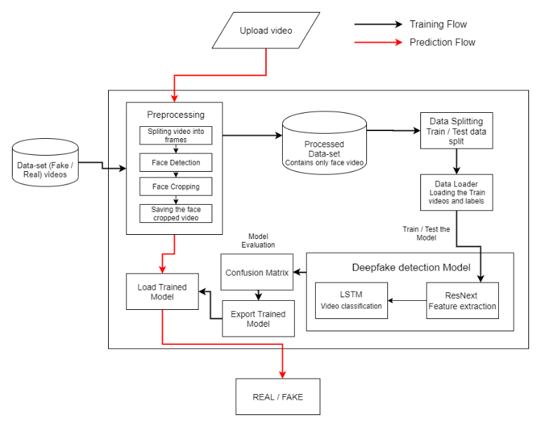
Architecture Diagram

Slide 12
Modules
1. Data Collection & Preprocessing
Gather datasets like FaceForensics++, Celeb-DF, and the Deepfake Detection Challenge dataset.
Perform data cleaning, augmentation, and format conversion.
Normalize and resize video frames for consistency.
2. Feature Extraction (CNN-based Analysis)
Use a Convolutional Neural Network (CNN) (e.g., ResNeXt) to extract frame-level features.
Identify deepfake artifacts such as pixel inconsistencies, unnatural lighting, and facial distortions.
3. Temporal Analysis (LSTM-based Analysis)
Use Long Short-Term Memory (LSTM) networks to analyze frame sequences over time.
Detect inconsistencies in facial movements and expressions that occur across frames.
4. Model Training & Evaluation
Train the deep learning model using labeled real and fake videos.
Evaluate performance with accuracy, precision, recall, and F1-score.
Optimize hyperparameters for better deepfake detection.
5. Deployment & Real-Time Detection
Convert the trained model into a deployable format (e.g., TensorFlow/ONNX).
Integrate with a real-time video processing system for live detection.
Test the system with real-world videos and enhance detection accuracy.

Slide 13
Software Components
1. Programming Language:
Python3 – Primary language for AI/ML model development, data processing, and automation.
JavaScript – For frontend development.
2. Web & API Development
Django(Backend)- For backend processing and user management.
HTML5,CSS3,JavaScript- For basic frontend structure.
Bootstrap- For UI styling.
3. Machine Learning & Deep Learning Models
CNN-based Face Forgery Detection – Trained on deep fake datasets
RNN/LSTM-based Temporal Analysis – For detecting inconsistencies in facial movements
4. Datasets
FaceForensics++ – A dataset for training deep fake detection.
DeepFakeDetection Challenge (DFDC) Dataset – Pretrained dataset from Facebook’s DFDC dataset.
Celeb_DF - A Large-Scale Challenging Dataset for Deepfake Forensics
Integrated Development Environment(IDE):
Visual Studio Code - A code editor for writing and debugging Python, JavaScript, and web components.

Slide 14
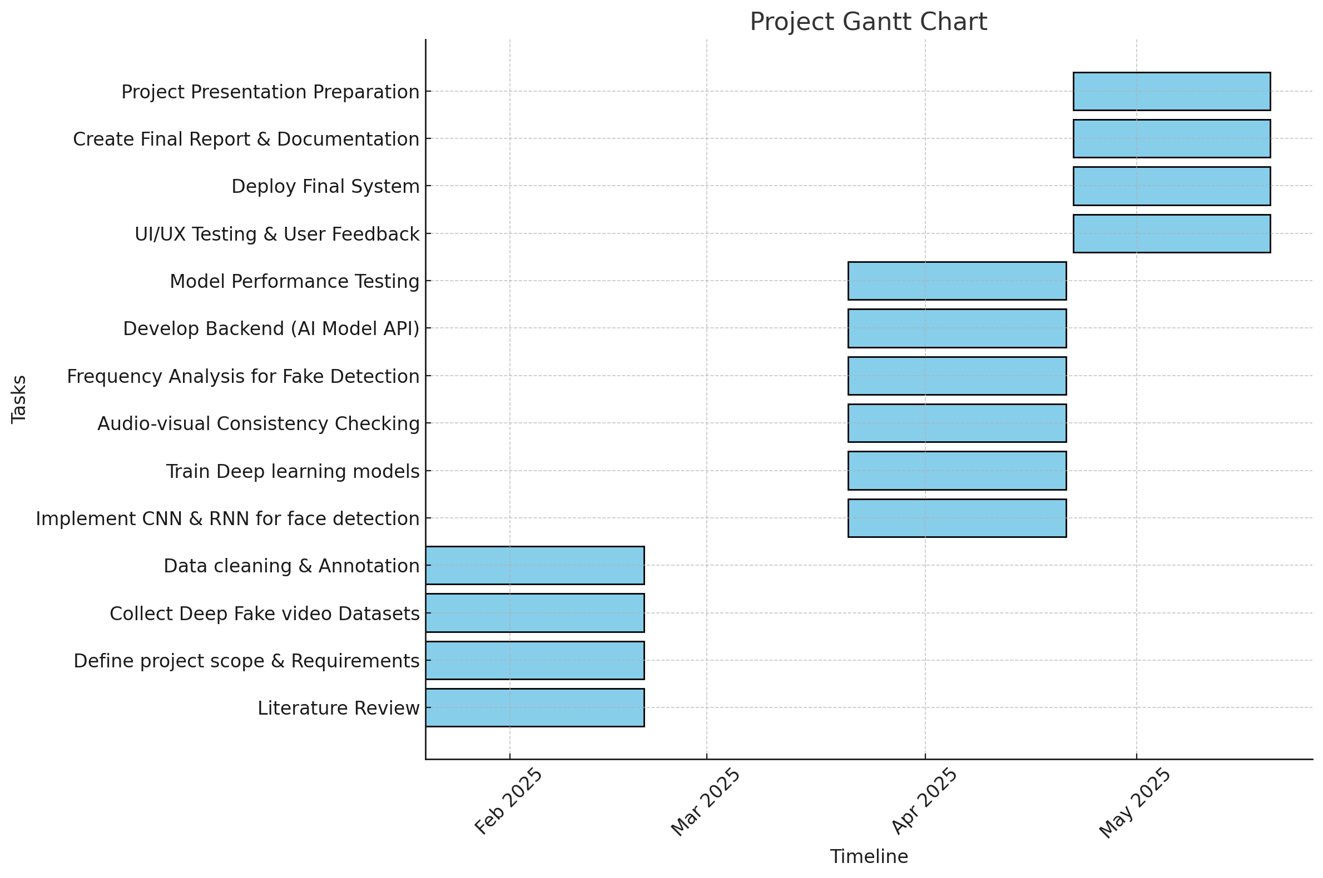
Timeline of the Project (Gantt Chart)

Slide 15
References (IEEE Paper format)
[1]. A. Rössler, D. Cozzolino, L. Verdoliva, C. Riess, J. Thies, and M. Niessner, “FaceForensics++: Learning to Detect Manipulated Facial Images,” IEEE Xplore, Oct. 01, 2019. https://ieeexplore.ieee.org/document/9010912
[2]. R. Durall, M. Keuper, F.-J. Pfreundt, and J. Keuper, “Unmasking DeepFakes with simple Features,” arXiv:1911.00686 [cs, stat], Mar. 2020, Available: https://arxiv.org/abs/1911.00686
[3]. Y. Li, X. Yang, P. Sun, H. Qi, and S. Lyu, “Celeb-DF: A Large-scale Challenging Dataset for DeepFake Forensics,” arxiv.org, Sep. 2019, Available: https://arxiv.org/abs/1909.12962
[4]. B. Dolhansky et al., “The DeepFake Detection Challenge Dataset,” arXiv:2006.07397 [cs], Jun. 2020, Available: https://arxiv.org/abs/2006.07397
[5]. R. Tolosana, R. Vera-Rodriguez, J. Fierrez, A. Morales, and J. Ortega-Garcia, “DeepFakes and Beyond: A Survey of Face Manipulation and Fake Detection,” arXiv:2001.00179 [cs], Jun. 2020, Available: https://arxiv.org/abs/2001.00179
[6]. N. Bonettini, E. D. Cannas, S. Mandelli, L. Bondi, P. Bestagini, and S. Tubaro, “Video Face Manipulation Detection Through Ensemble of CNNs,” arXiv:2004.07676 [cs, eess], Apr. 2020, Available: https://arxiv.org/abs/2004.07676

Slide 16
References (IEEE Paper format)
[7]. N. Bonettini, E. D. Cannas, S. Mandelli, L. Bondi, P. Bestagini, and S. Tubaro, “Video Face Manipulation Detection Through Ensemble of CNNs,” arXiv:2004.07676 [cs, eess], Apr. 2020, Available: https://arxiv.org/abs/2004.07676
[8]. T. Zhao, X. Xu, M. Xu, H. Ding, Y. Xiong, and W. Xia, “Learning Self-Consistency for Deepfake Detection.” Available:https://openaccess.thecvf.com/content/ICCV2021/papers/Zhao_Learning_Self-Consistency_for_Deepfake_Detection_ICCV_2021_paper.pdf
[9]. S. Dong, J. Wang, J. Liang, H. Fan, and R. Ji, “Explaining Deepfake Detection by Analysing Image Matching,” arXiv.org, 2022. https://arxiv.org/abs/2207.09679 (accessed Feb. 21, 2025).
[10]. A. Jain, N. Memon, and J. Togelius, “A Dataless FaceSwap Detection Approach Using Synthetic Images,” arXiv (Cornell University), Dec. 2022, doi: https://doi.org/10.48550/arxiv.2212.02571.
[11]. K. Narayan, H. Agarwal, K. Thakral, S. Mittal, M. Vatsa, and R. Singh, “DF-Platter: Multi-Face Heterogeneous Deepfake Dataset.” Accessed: Feb. 21, 2025. [Online]. Available: https://openaccess.thecvf.com/content/CVPR2023/papers/Narayan_DF-Platter_Multi-Face_Heterogeneous_Deepfake_Dataset_CVPR_2023_paper.pdf
[12]. “Applied Soft Computing | Journal | ScienceDirect.com by Elsevier,” www.sciencedirect.com. https://www.sciencedirect.com/journal/applied-soft-computing
[13]. C. Peng, H. Guo, D. Liu, N. Wang, R. Hu, and X. Gao, “DeepFidelity: Perceptual Forgery Fidelity Assessment for Deepfake Detection,” arXiv.org, 2023. https://arxiv.org/abs/2312.04961 (accessed Feb.

Slide 17
Github Repository Link
GITHUB LINK :-
https://github.com/NikithaPeddisetty/Development-of-AI-ML- based-solution-for-detection-of-face-swap-based-deep-fake-videos
DRIVE LINK:-
https://drive.google.com/drive/folders/1PvU- 0ZvK9l4f3vGU8CsYauuuovyFd3sj?usp=drive_link

Slide 18


